Slide 1

Israel Palestine War
Analysis
Anupriya Balasubramanian
GitHub- https://github.com/abanusara99/mentorness/tree/main/isreal

Slide 2
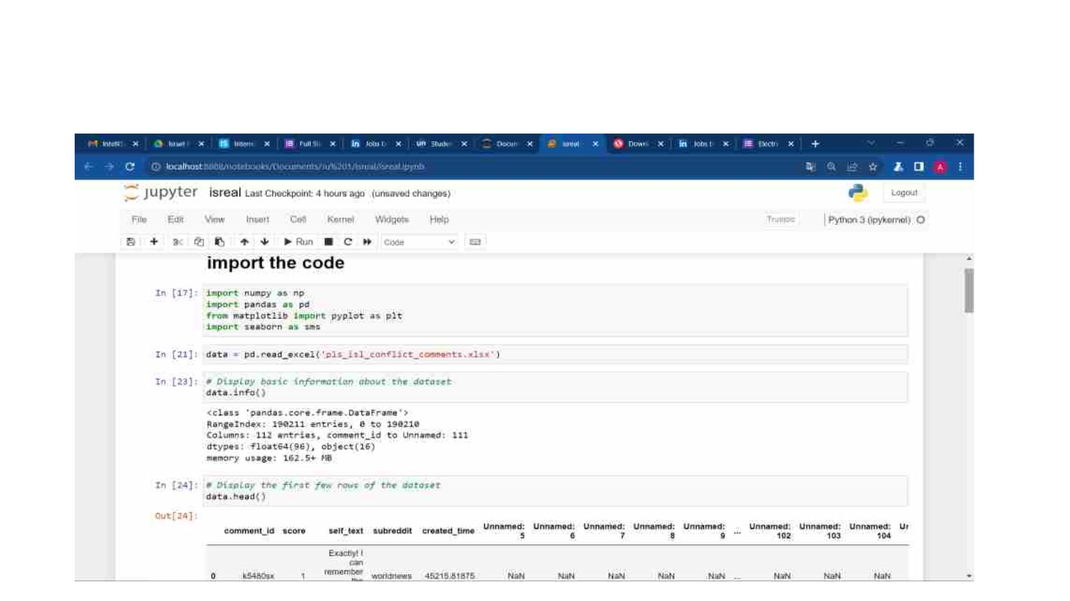
Import libraries, read, info, and display the columns

Slide 3
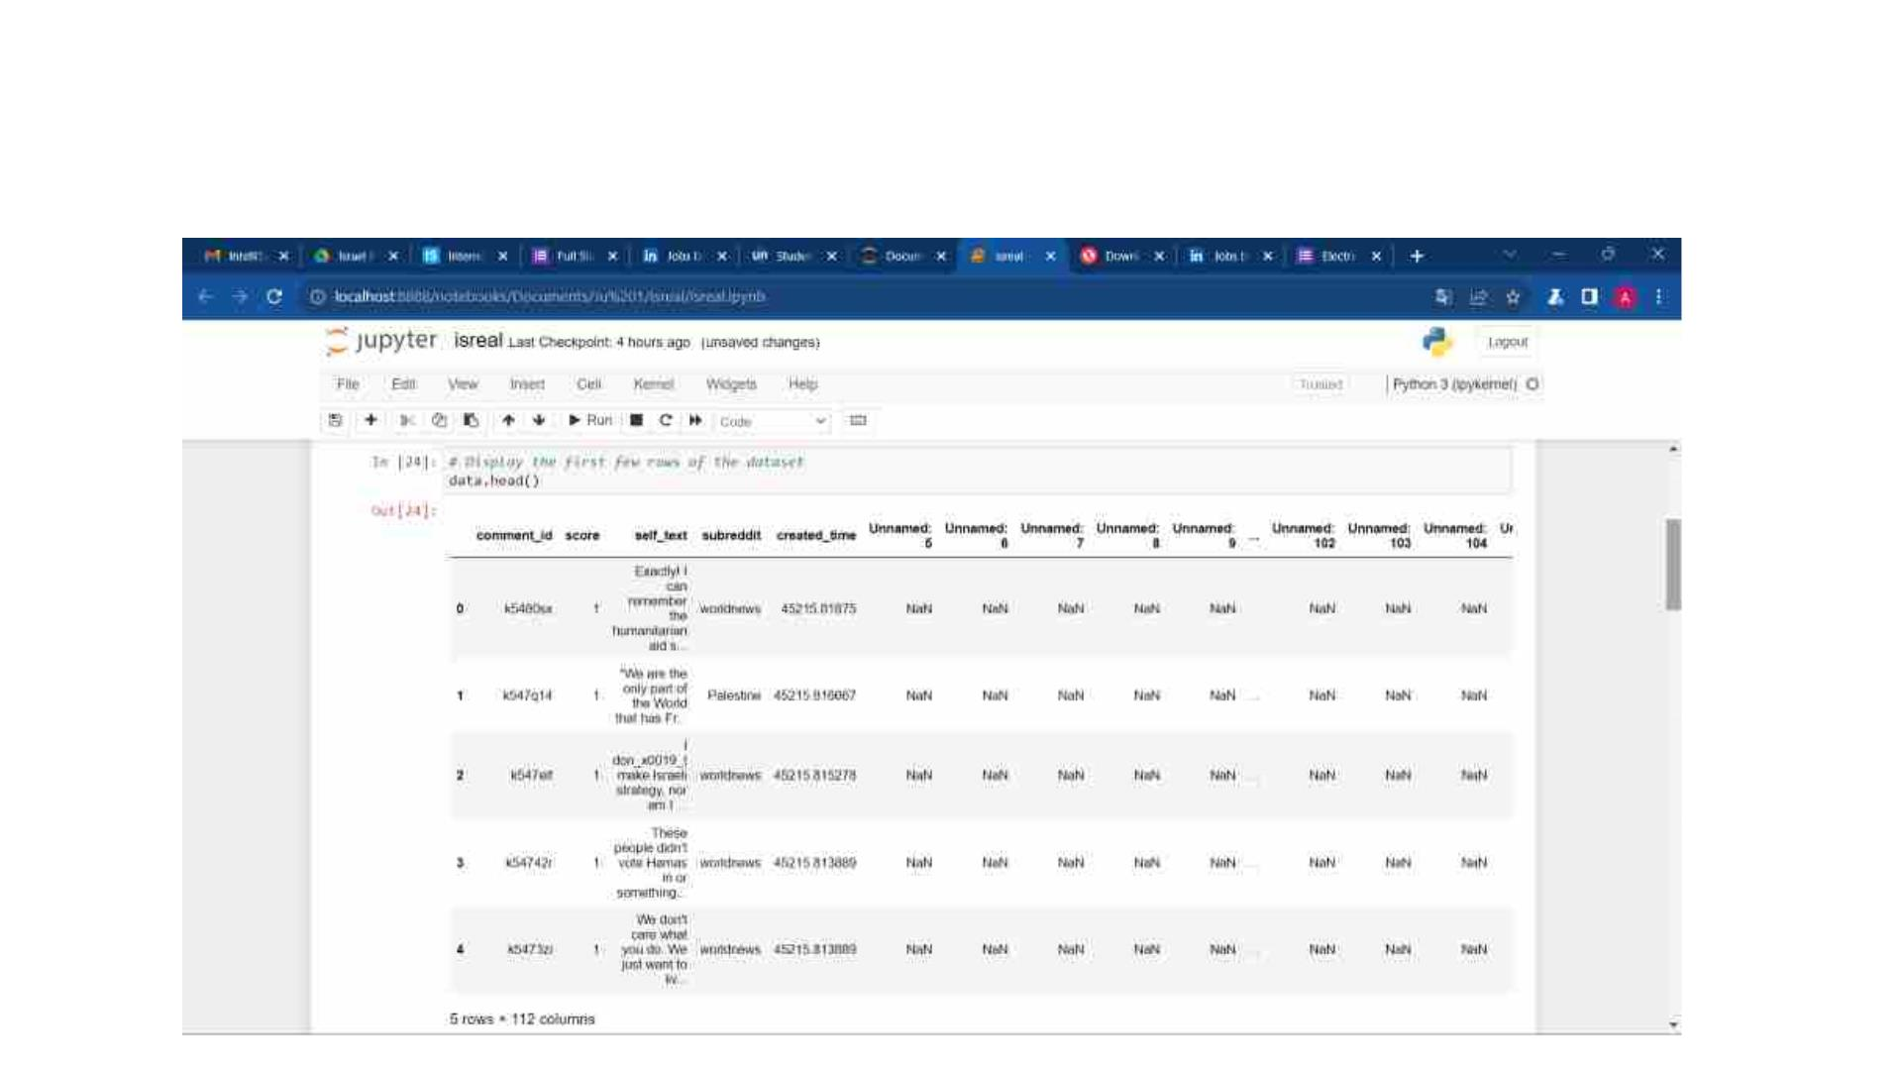
5*112 display the columns

Slide 4
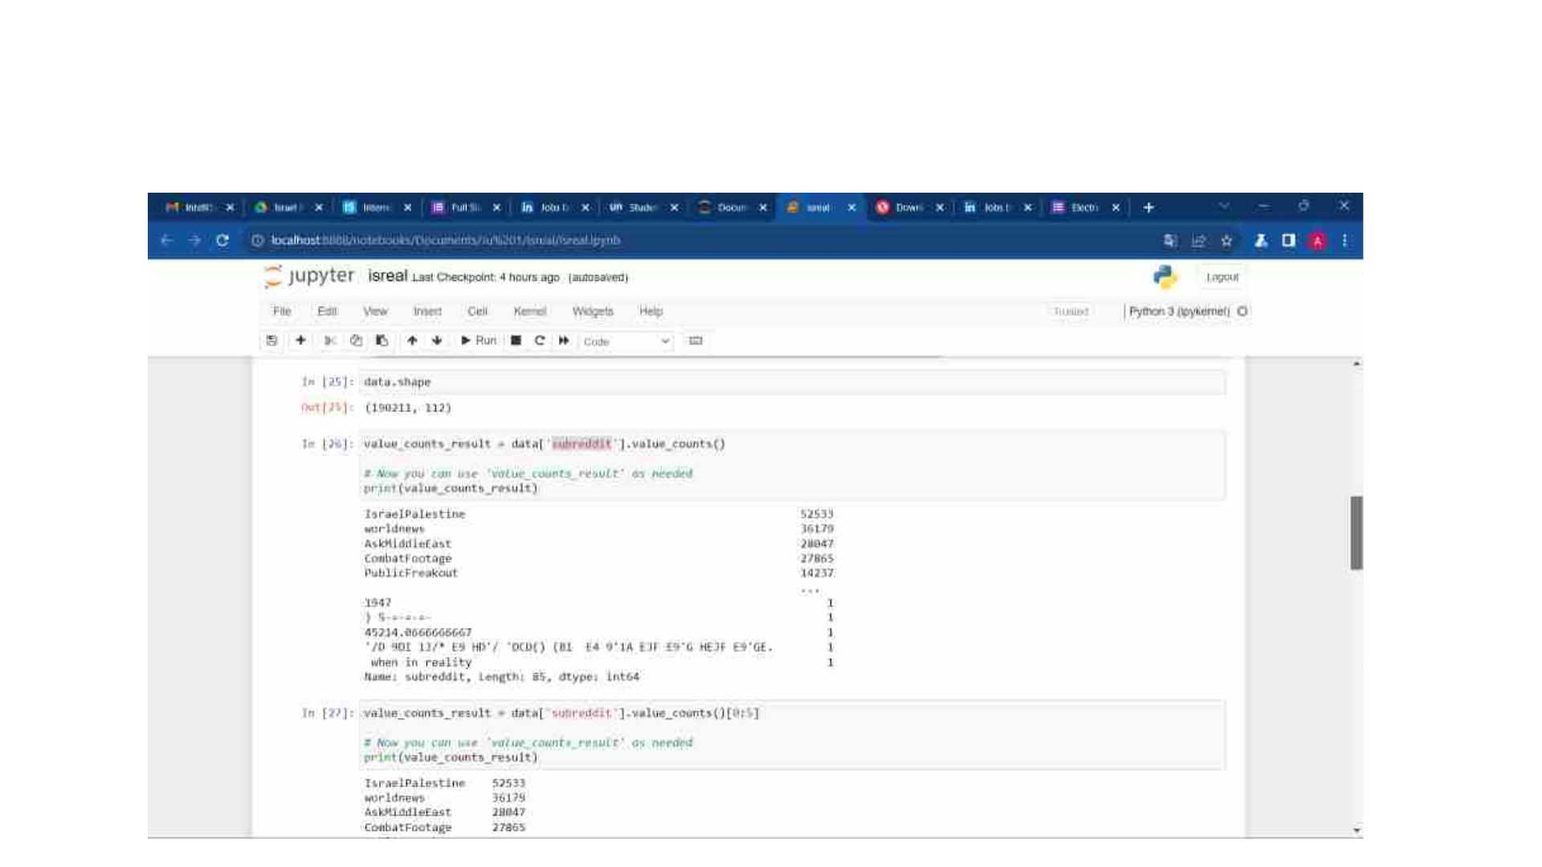
View value count of subreddit

Slide 5
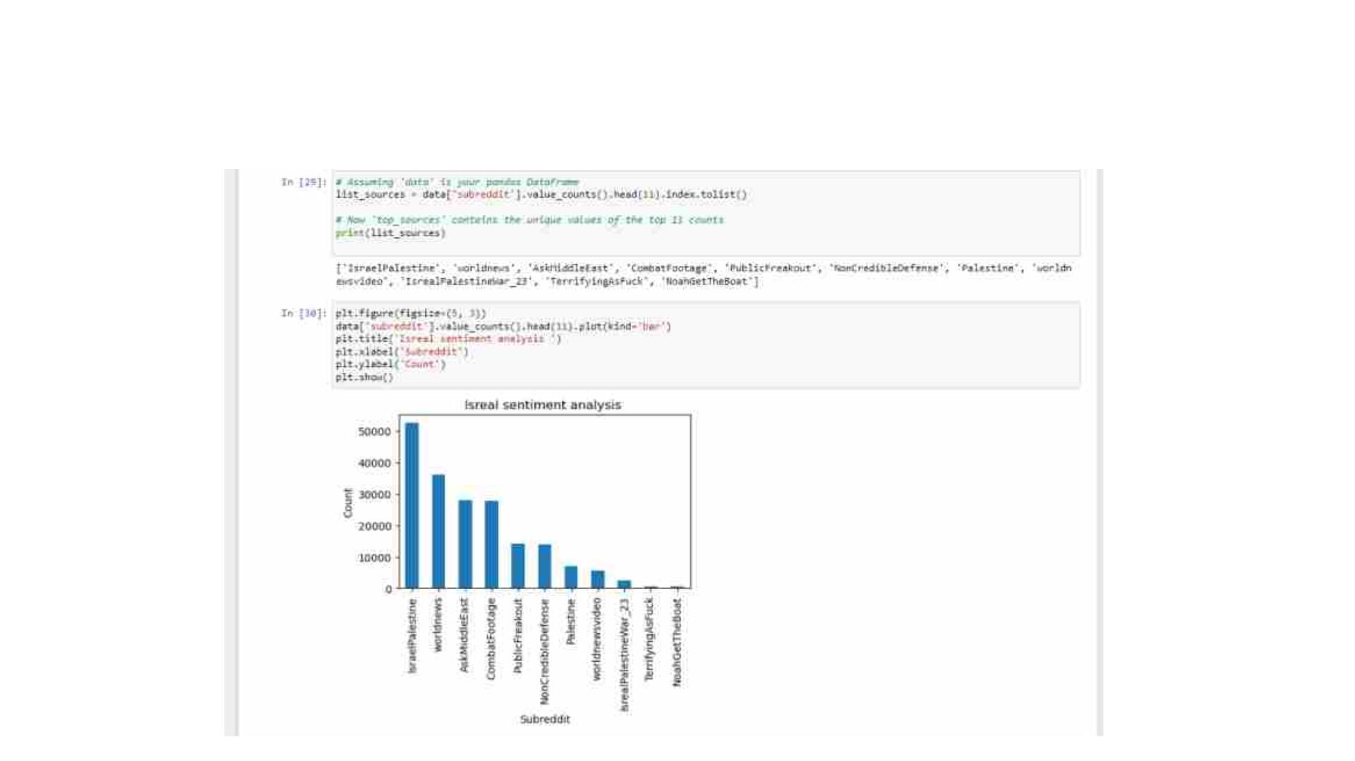
Bar chart of subreddit

Slide 6
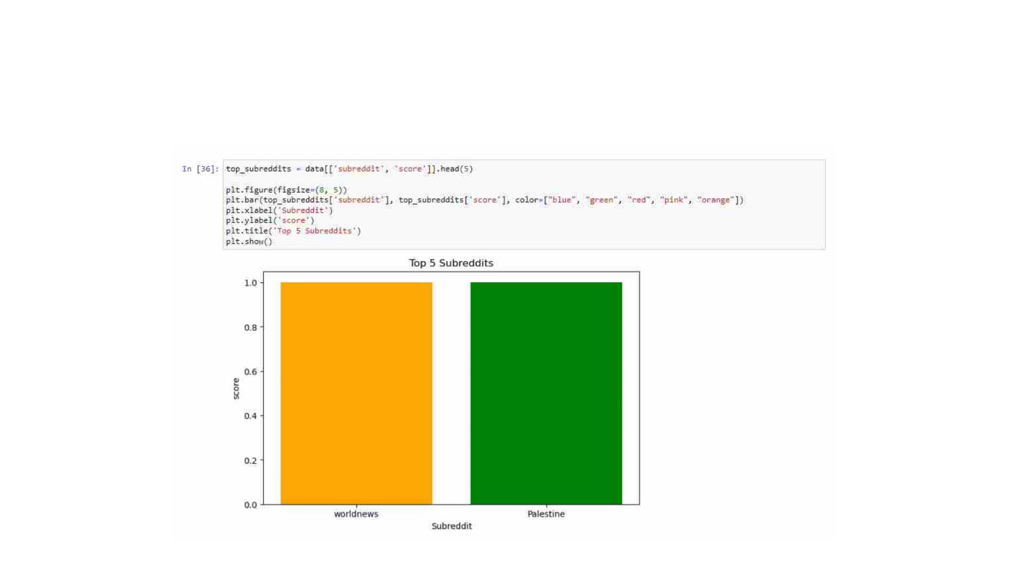
Color bar chart of subreddit

Slide 7
THANK YOU

